Slide 1
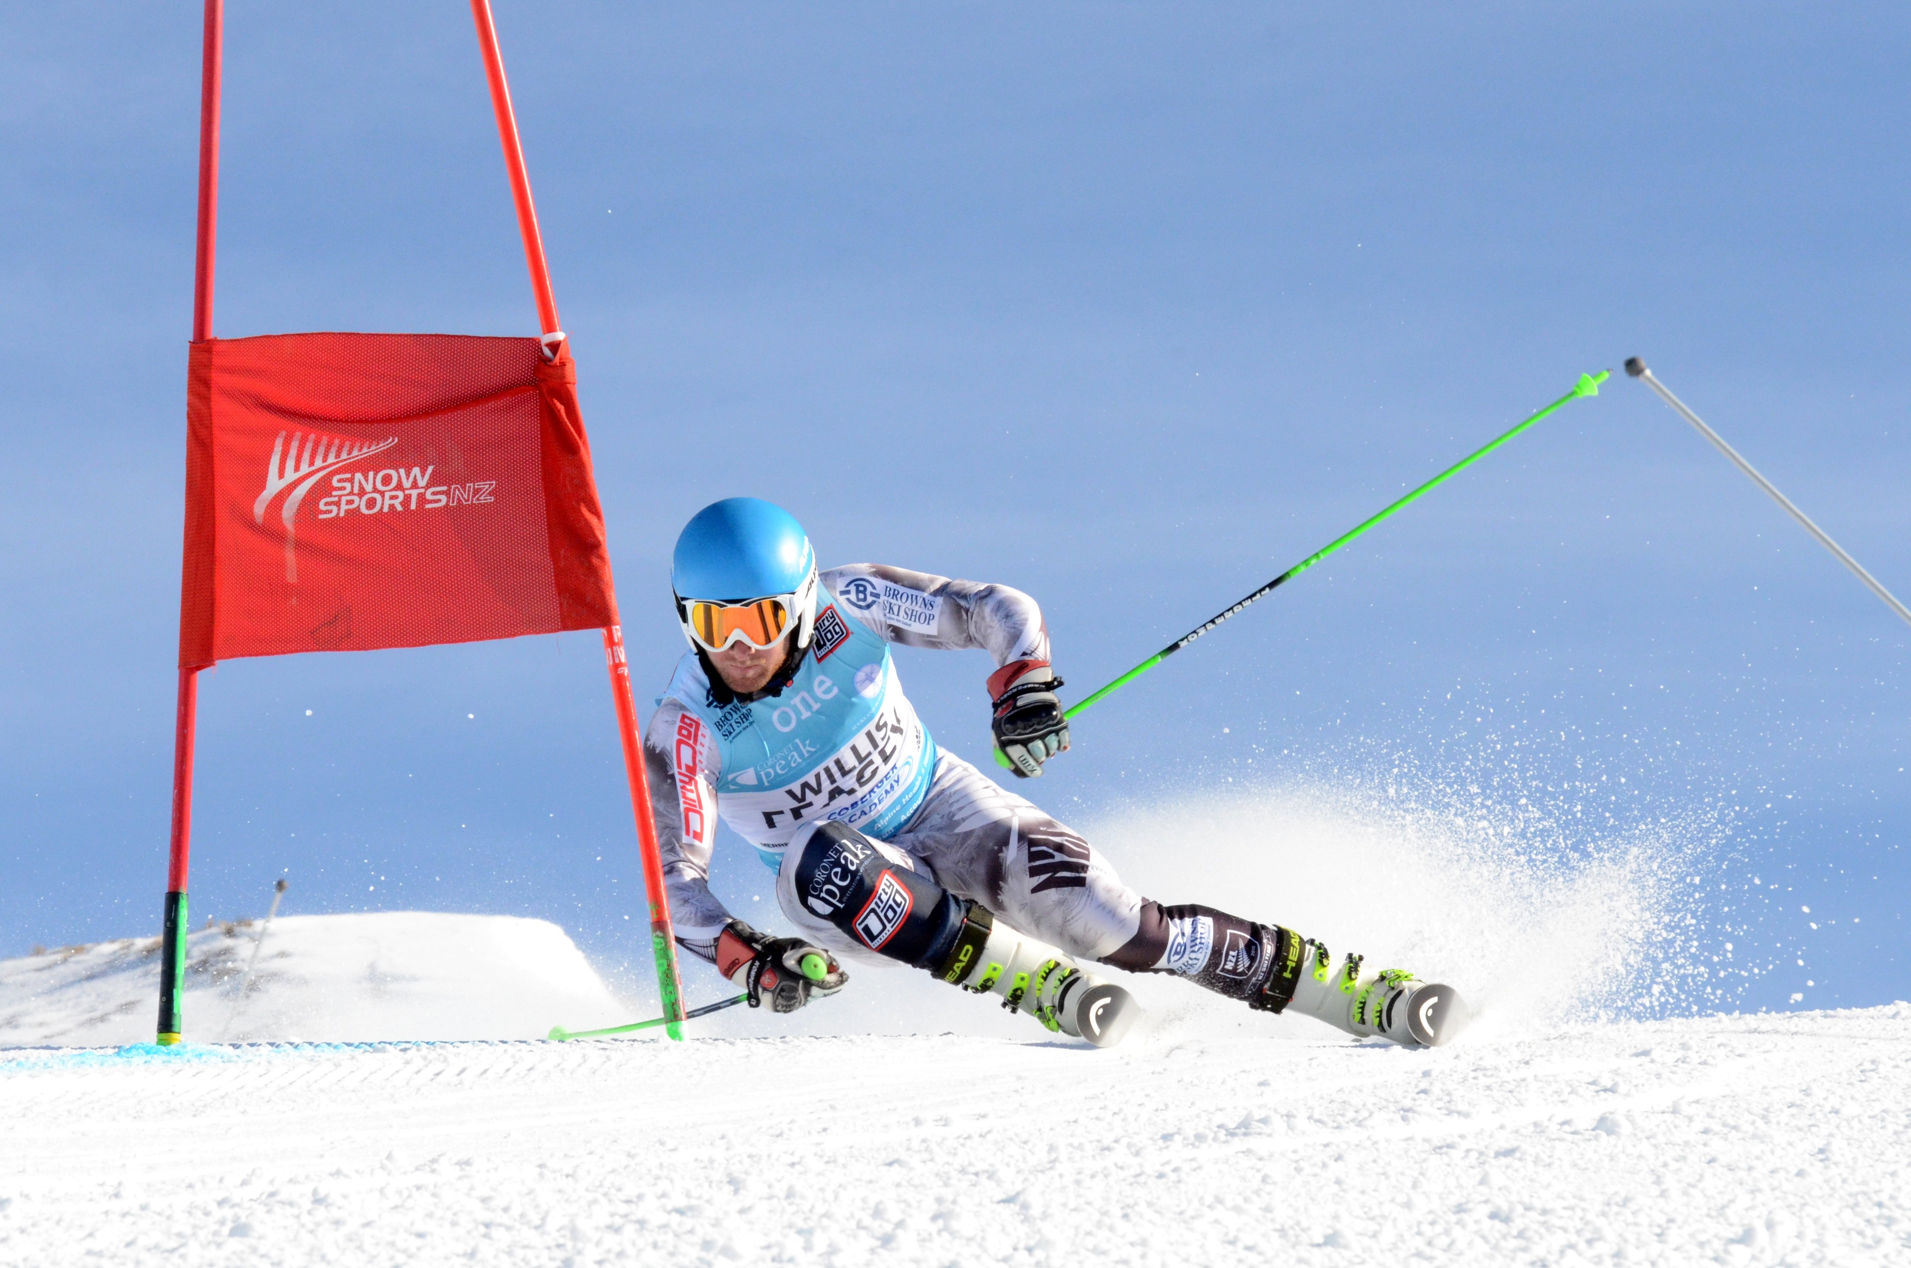

Health and Safety Update 2016
Notes:
Our Vision : New Zealand’s most inspirational, innovative, exciting and fun sport
Our Mission : To lead and support the growth and success of competitive snow sports in New Zealand

Slide 2
Health and safety at work act (2015)
Came into force on 4th April 2016
Aim is to decrease preventable deaths (1) & work-related illnesses (15)
Primarily aimed at death industries (construction, farming, forestry, fishing and mining)
BUT
Applies to all industries and workplaces defined as a PCBU (person conducting a business or undertaking)
Liability resides with Directors and Officers (e.g. CEO) deliberate attempt to change H&S culture
Notes:
Small organisation trying to do good things – majority of income is tagged toward events, equipment or programmes (outcomes)
Snow sports in NZL reliant on commercial operators (ski areas)

Slide 3
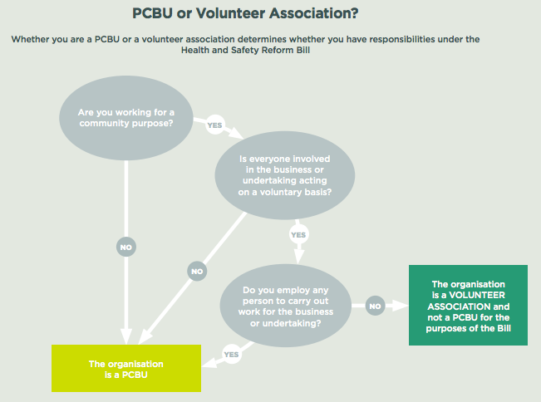
Notes:
But wait there’s more….

Slide 4
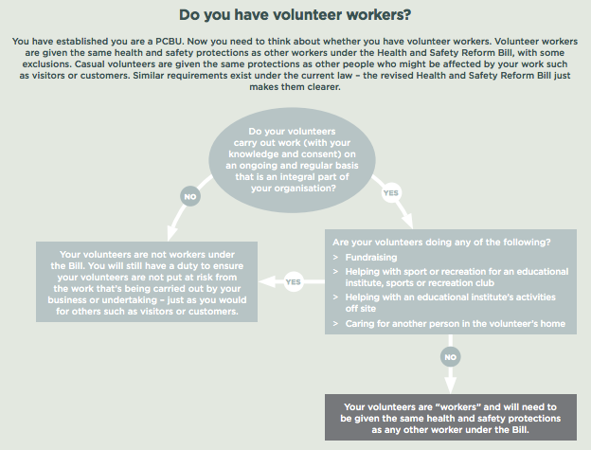
Notes:
Riglets → Auckland (Snowplanet, Sport Nth Harbour)
FUNdamentals (6000 booklets distributed)
Talent Development and High Performance

Slide 5
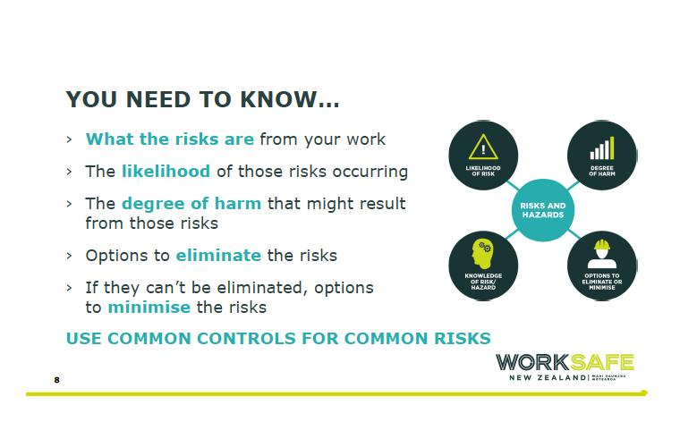
Notes:
But wait there’s more….

Slide 6
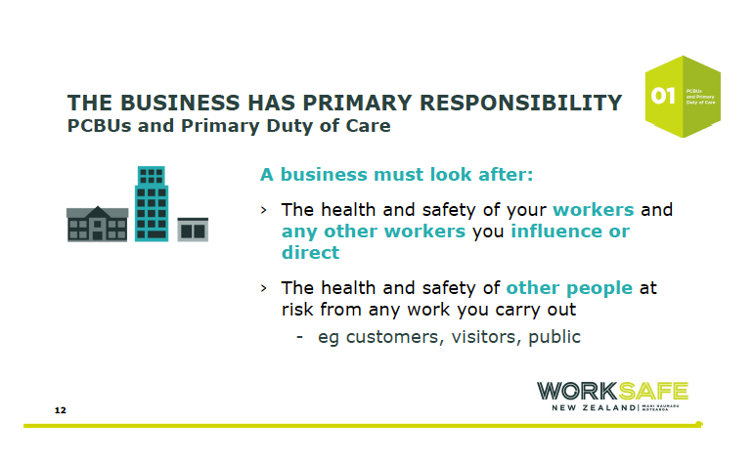
Notes:
But wait there’s more….

Slide 7
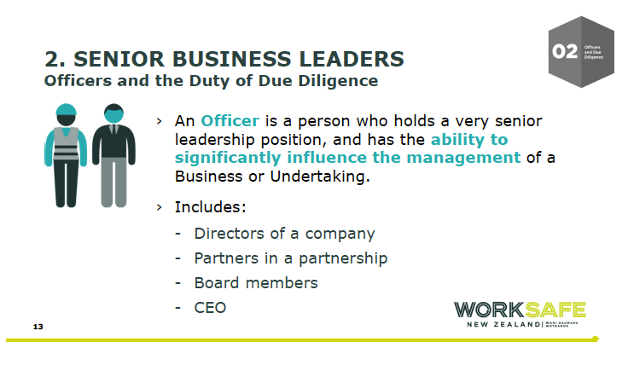
Notes:
But wait there’s more….

Slide 8
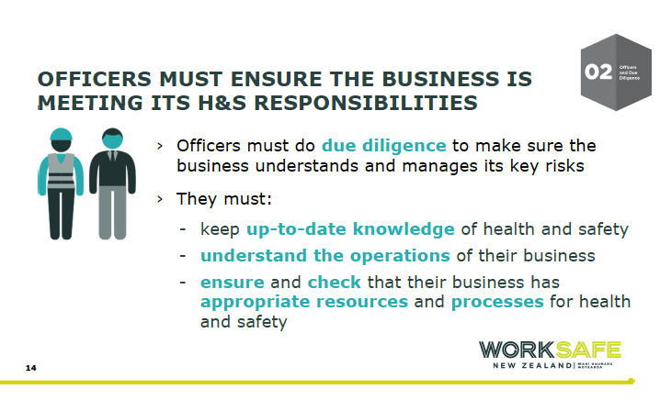
Notes:
But wait there’s more….

Slide 9
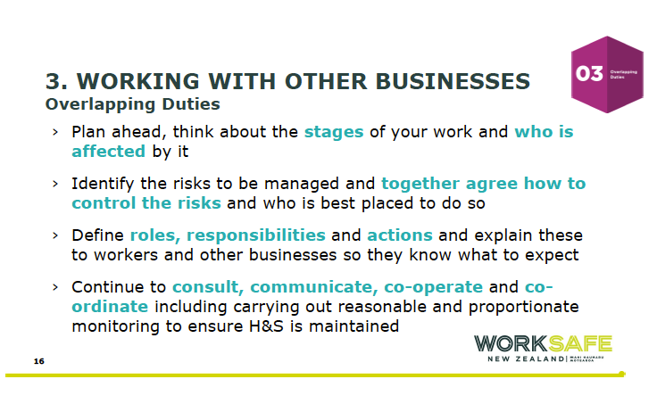
Notes:
But wait there’s more….

Slide 10
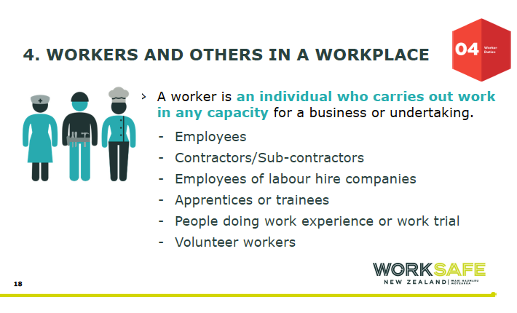
Notes:
But wait there’s more….

Slide 11
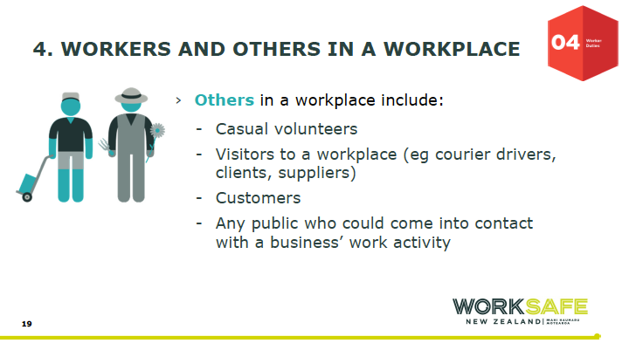
Notes:
But wait there’s more….

Slide 12
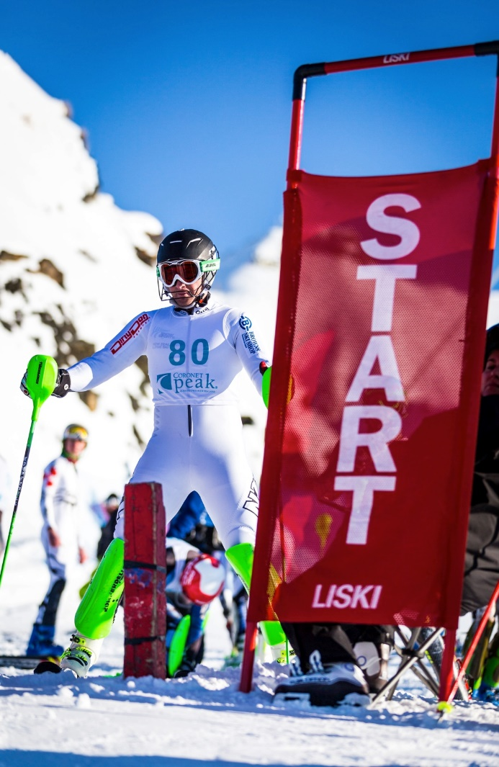
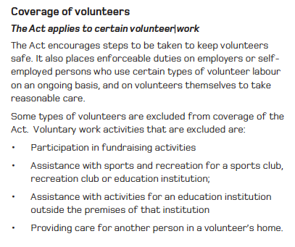
Notes:
But wait there’s more….

Slide 13
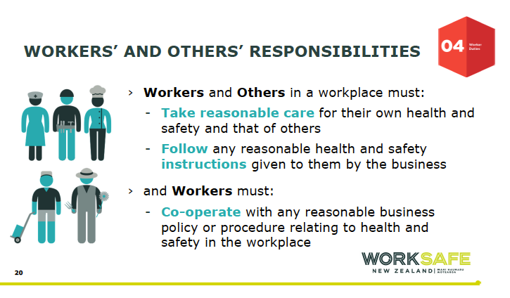
Notes:
But wait there’s more….

Slide 14
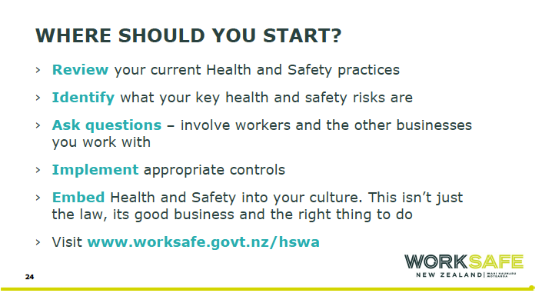
Notes:
But wait there’s more….

Slide 15
Places to go for more information
WorkSafe NZ www.business.govt.nz/worksafe
Sport NZ www.sportnz.org.nz
Institute of Directors www.iod.org.nz/healthandsafety
Notes:
But wait there’s more….

Slide 16
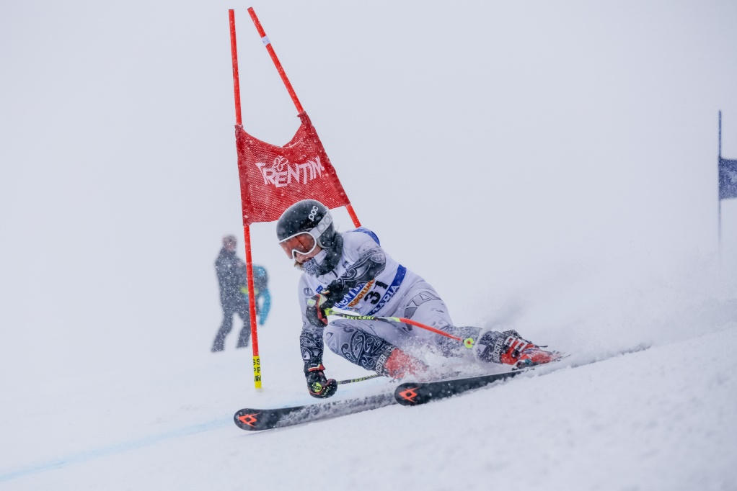

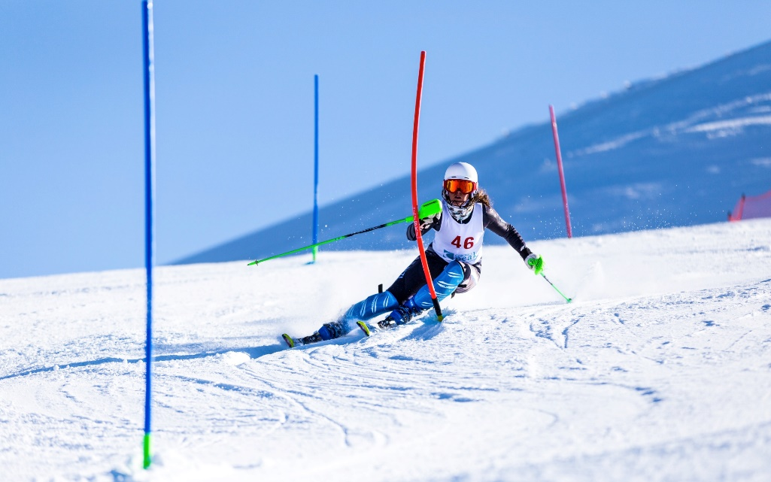
aim is to keep staff and athletes safe
Notes:
But wait there’s more….

